Slide 1

Project Title – Healthcare Analytics For Doctor Visit TIRTC
Student Name :- Nisha Kishorji Borse
College Name :- R.C.P.E.T's Institute of Management Research and Development, Shirpur
AICTE STU ID :- STU67650ae7b49901734675175

Slide 2

PROBLEM STATEMENT
Healthcare organizations generate large amounts of patient data related
to doctor visits, health conditions, income levels, age groups, and medical histories.
However, identifying the factors that influence hospital visits and healthcare utilization
can be challenging without proper data analysis.
This project aims to analyze patient healthcare records to understand how
demographic, economic, and health-related factors affect the frequency of doctor
visits. By examining variables such as age, gender, income, illness severity, reduced
activity days, and chronic health conditions, the project seeks to uncover meaningful
patterns and insights that can support better healthcare planning, resource allocation,
and patient care decisions.

Slide 3
Project Description
The Healthcare Analytics for Doctor Visits project focuses on analyzing patient healthcare data to understand the factors that influence the frequency of doctor consultations and healthcare service utilization.
Healthcare providers often collect large volumes of patient information, including demographic details, income levels, health conditions, illness severity, and medical histories.
Transforming this data into meaningful insights can help healthcare organizations improve decision-making and patient care.
In this project, data analysis techniques were applied to examine relationships between patient characteristics and doctor visit patterns.
The dataset was cleaned, processed, and analyzed using Python libraries such as Pandas, NumPy, Matplotlib, and Seaborn.
Exploratory Data Analysis (EDA) was performed to identify trends, distributions, correlations, and key factors affecting healthcare utilization.
The analysis provides insights into how variables such as age, gender, income, illness severity, reduced activity days, and chronic health conditions impact the number of doctor visits.
These findings can assist healthcare professionals, hospitals, and policymakers in improving resource allocation, enhancing patient care strategies, and making data-driven healthcare decisions.

Slide 4

WHO ARE THE END USERS?
The primary end users of this healthcare analytics solution are:
• Healthcare Administrators – To monitor patient visit trends, optimize resource allocation, and improve operational efficiency.
• Hospital Management Teams – To make data-driven decisions regarding staffing, scheduling, and healthcare service planning.
• Doctors and Medical Professionals – To understand patient healthcare patterns and identify factors influencing doctor visits.
• Healthcare Analysts and Researchers – To analyze patient data, discover trends, and support healthcare research initiatives.
• Government Health Departments and Policymakers – To evaluate healthcare utilization patterns and develop effective public health policies.
• Insurance Companies – To assess healthcare usage trends and support risk assessment and policy planning.
These users can leverage the insights generated from the analysis to improve healthcare services, enhance patient outcomes, and make informed strategic decisions.

Slide 5
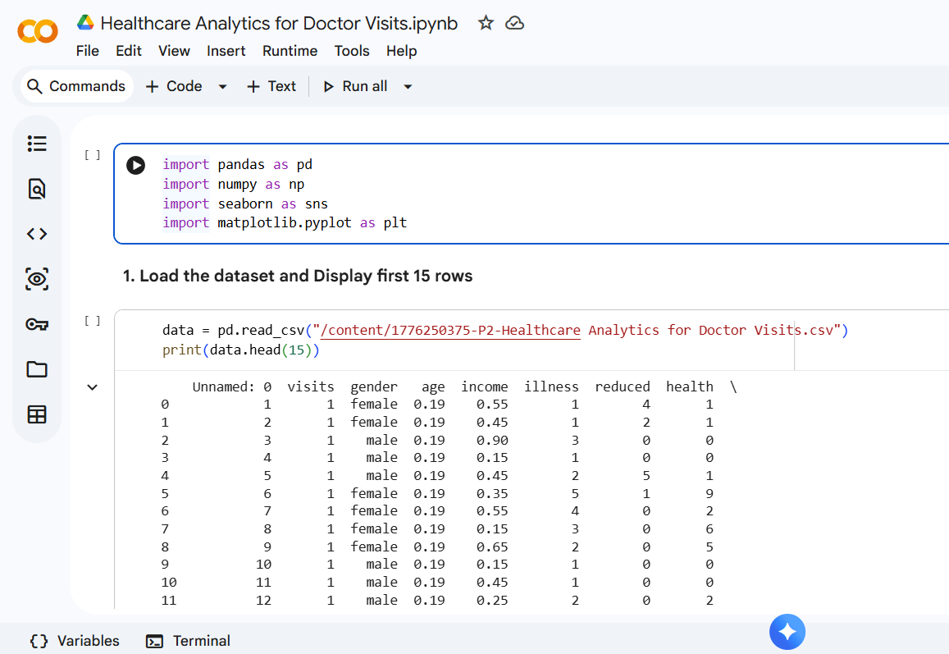

Technology Used
  The VOIS program specifically describes Python data analytics skills including Pandas, data cleaning/transformation, EDA, descriptive statistics and Matplotlib visualization.
Technology | Purpose
Python | Data analysis
Google Colab | Development environment
Pandas | Data loading, cleaning & analysis
NumPy | Numerical operations
Matplotlib | Data visualization
Seaborn | Statistical visualization

Slide 6
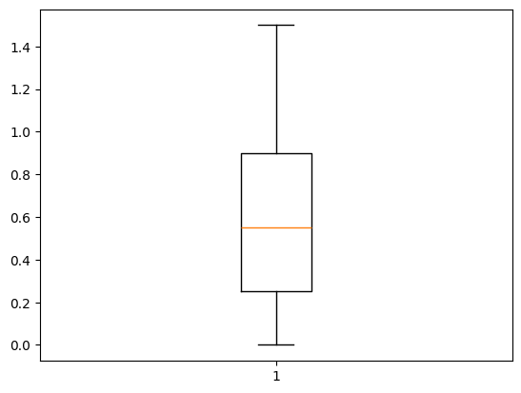
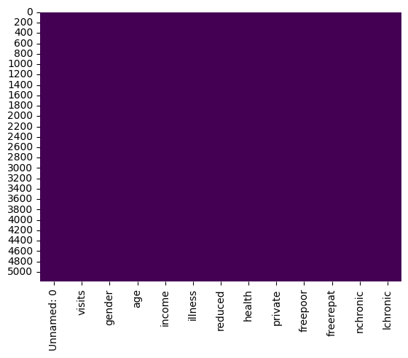
RESULTS
1. Income Box Plot
This box plot is used to understand the distribution of patient income. It helps identify the minimum income, maximum income, median income, and any outliers. Most patients fall within a specific income range, while a few patients have significantly higher or lower incomes.
2. Missing Values Heatmap
This heatmap helps check whether the dataset contains missing values. Since there are very few or no highlighted gaps, the dataset is clean and suitable for analysis.
Demo Link

Slide 7
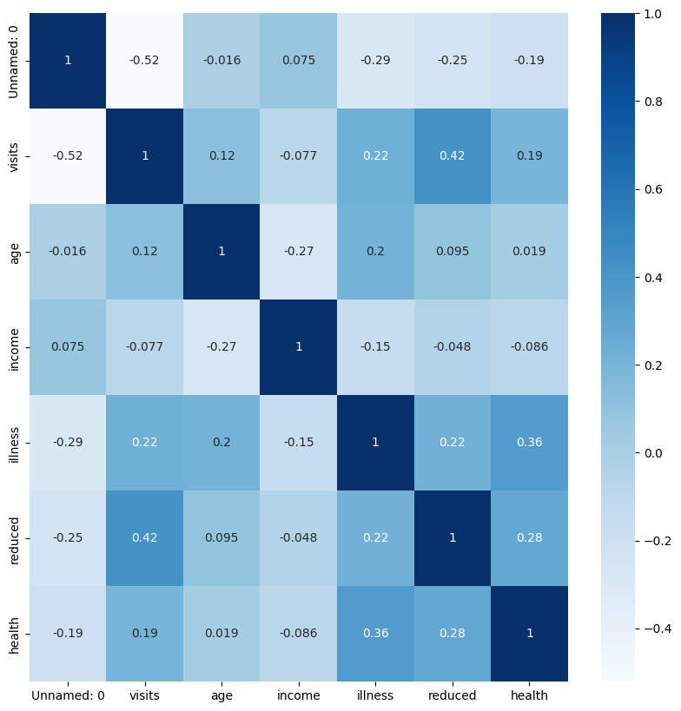
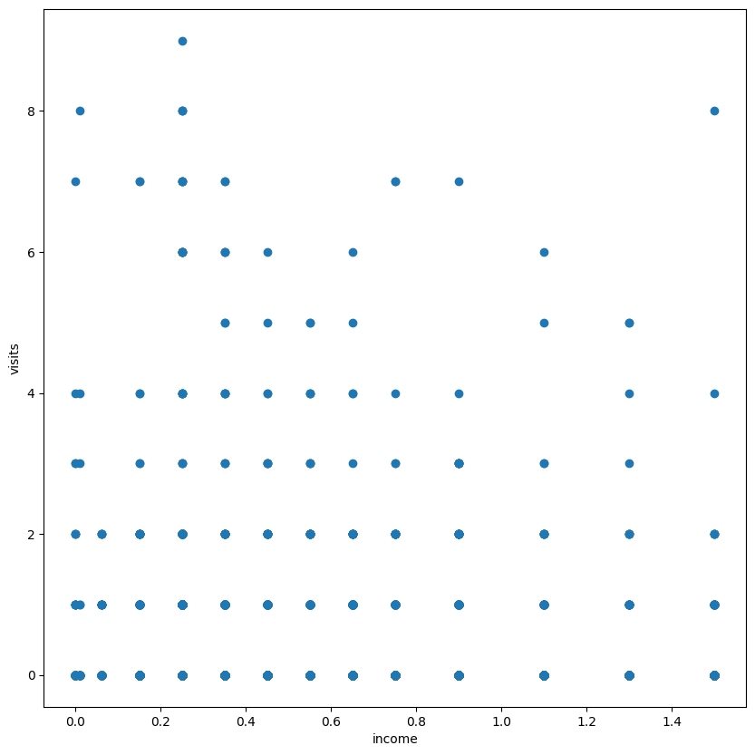
RESULTS
3. Correlation Heatmap
This chart shows the relationship between different variables. Darker colors indicate stronger relationships, while lighter colors indicate weaker relationships. It helps identify which factors are most closely related to doctor visits
4. Income vs Doctor Visits Scatter Plot
This scatter plot analyzes whether patient income affects the number of doctor visits. Each point represents a patient. The chart helps identify trends between income levels and healthcare utilization.
Demo Link

Slide 8
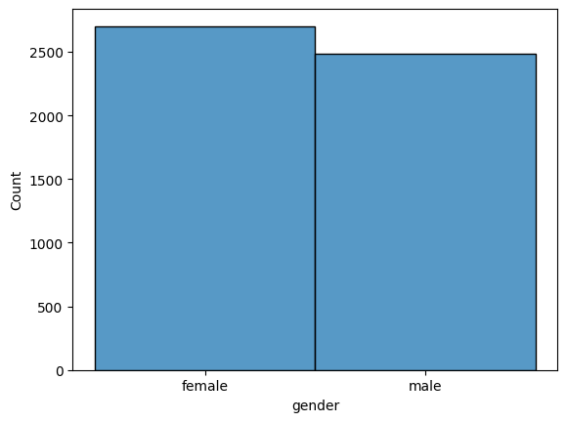
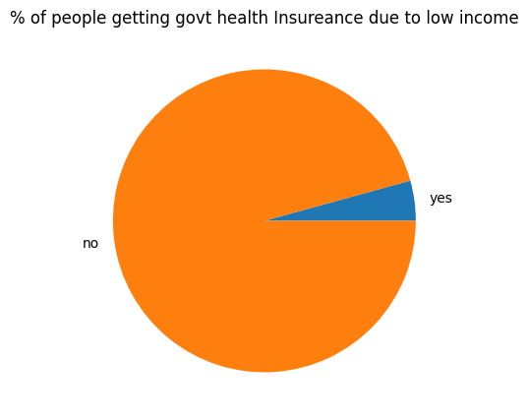
RESULTS
6. Government Insurance Due to Low Income
This pie chart shows the percentage of people receiving government health insurance because of low income. It helps understand how many patients depend on financial assistance for healthcare coverage.
5. Male vs Female Affected by Illness
This visualization compares the number of male and female patients affected by illness. It helps understand the distribution of illness across genders.
Demo Link

Slide 9
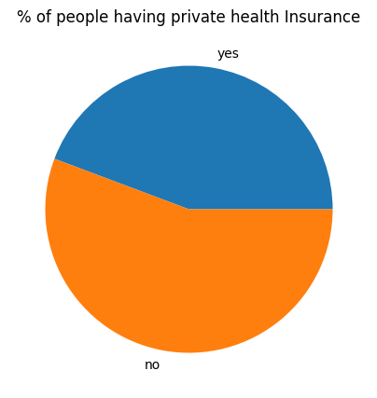
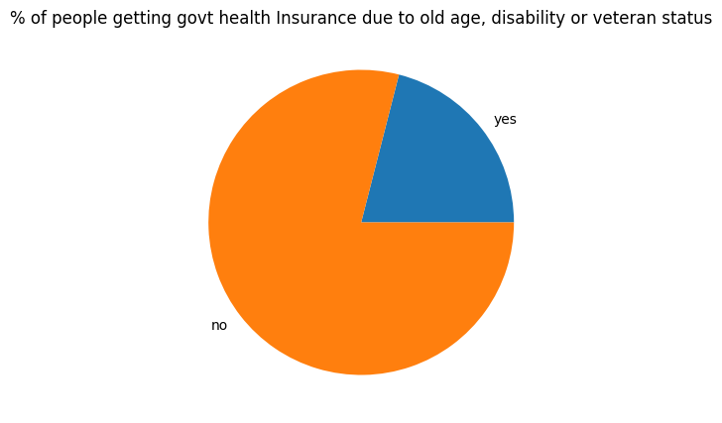
RESULTS
7. Private Health Insurance
This chart shows the proportion of patients who have private health insurance versus those who do not. It provides insights into healthcare coverage among patients.
8. Government Insurance Due to Old Age/Disability
This pie chart represents the percentage of people receiving government insurance because of old age, disability, or veteran status. It highlights support provided to vulnerable groups.
Demo Link

Slide 10
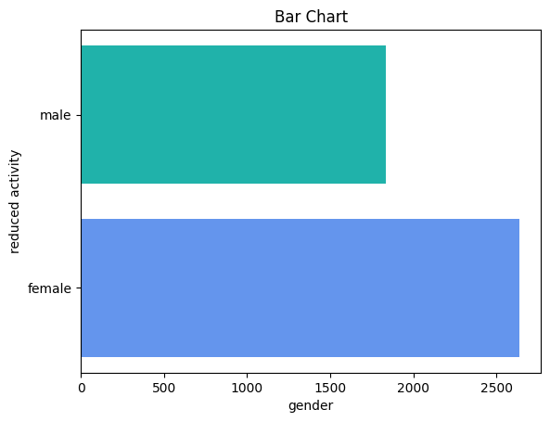
RESULTS
9. Reduced Activity Days by Gender
This horizontal bar chart compares the total number of reduced activity days due to illness for males and females. It helps identify which gender experiences a greater impact from illness on daily activities.
Demo Link

Slide 11
Thank you
GitHub Project Repository :
.

